Slide 1
Complex Survey Design AND Analysis, a Nationally Representative Georgian Serosurvey
Steven Russell, MSPH

Slide 2
Outline
Complex survey design concepts
Stratification
Clustering
Design Effect
Case study: Georgian serosurvey
Complex design
Sample size calculation
Household selection
Statistical analysis of complex survey data
Weighting
SAS and SPSS

Slide 3
What is Stratification?
Stratification is the process of:
Dividing members of the population into non-overlapping and mutually exhaustive subgroups (strata)
Sampling each strata independently

Slide 4

What is Stratification?
Population
Stratum #1
Stratum #2
Stratum #3
Stratum #4
Notes:
So here we have a population of people that we want to sample. But instead of doing a simple random sample from this whole group, we will separate our population into 4 different strata. Then we will take a random sample of people from each of those strata. We sample some people from stratum 1, then we sample people in stratum 2, 3, and 4.
And then we recombine all those people into a final sample

Slide 5
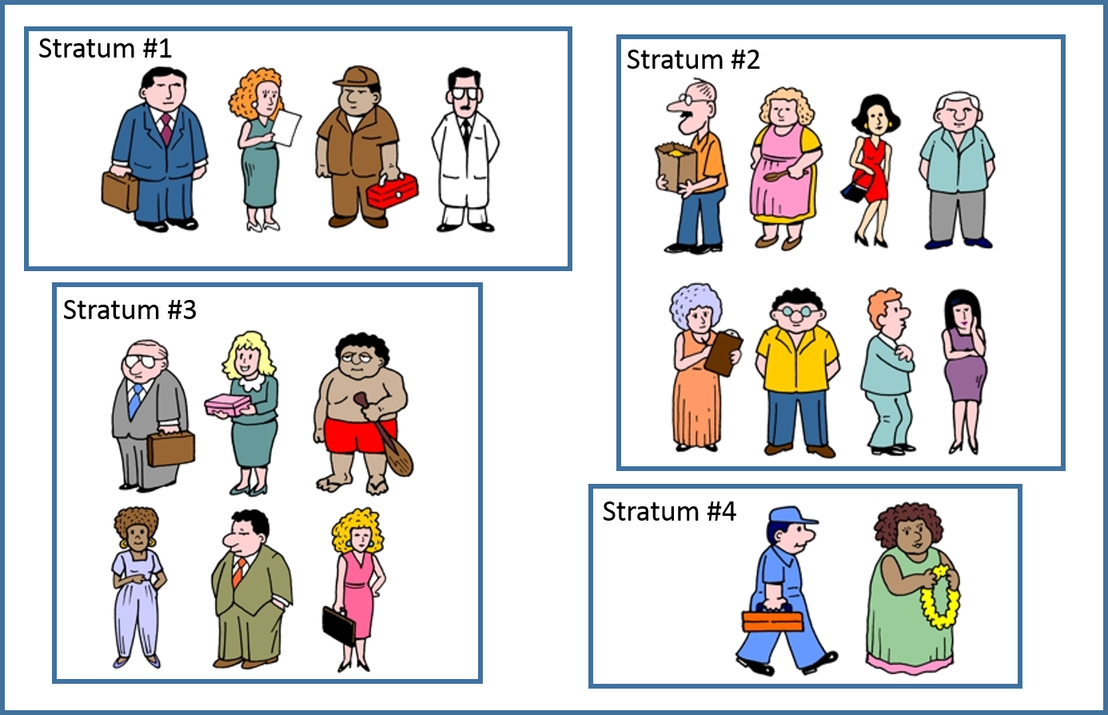









What is Stratification?
Population
Sample

Slide 6
Stratified Sampling
Advantages
A stratified sample will achieve greater precision than a simple random sample
Don’t need as large of a sample size
Saves time and money
The researcher can guarantee certain subgroups will be included in the final sample
Disadvantages
More complex to analyze the results (compared to simple random sampling)
Notes:
So what’s the purpose of doing this? Well, the big advantage is that we can achieve much better precision with a stratified random sample than we can with a simple random sample.
This means that we don’t have to survey as many people which saves us time an money
Additionally, the researcher can guarantee certain subgroups will be included in the final sample. For example, suppose you have some minority subgroup that only makes up 1% of the population. With stratified sampling, you make this subgroup into it’s own strata to ensure those people are correctly represented in your sample. In other words, you can guarantee that if they make up 1% of your population that they also make up 1% of your sample.
In random sampling, sample should be representative. But unless your collecting a huge amount of data it’s possible that nobody from that 1% subgroup is even chosen in the sample. Some groups will be over or underrepresented by chance.
But from a statistical perspective it makes a lot of sense to do it.

Slide 7
Allocation of a stratified sample
Proportional allocation (recommended)
Participants have equal probability of selection (self-weighting)
Most efficient for overall estimates
Equal allocation
More efficient is you are interested in subgroup estimates
Other allocations
Can be more efficient, depending on your goals
Notes:
Once you have decided to use stratification, the next step is to decide how you want to allocate your sample to the different strata.
Generally speaking you have 3 main options
The first option is proportional allocation which is what I would recommend in most instances. And the reason for this is that it maintains an equal probability of selection for all the people in your population. What this is going to do is help make the process of weighting much easier down the line. We call this self-weighting because it means all of our base weights will be exactly the same. If people had different probabilities of selection, we would need to account for that with additional weights.
A 2nd option is Equal allocation. You can use this if you want really good estimates for your individual strata. Or for individual demographic groups. Equal allocation will be a more efficient use of sample for subgroup estimates but will be less efficient for overall estimates.
Then you have 3rd option which I call other allocations. And this is sort of a catch-all category. These custom allocations can be more efficient depending on the goals of your study, and I’ll actually you are going to be able to see the concepts in the context of the HCV study a little later.

Slide 8
Proportional Allocation
Population
Sample
Notes:
So that first graphic I should you for stratification was actually an example of proportional allocation, and you can see it again here. In proportional allocation, in each strata, we are going to take a sample size that is proportional to the size of the strata. So here we are taking a sample that is 50% of the size of each strata. In stratum #2, we are taking 4 people (out of 8) . In stratum #4 we are taking 1 person (out of 2). The bigger stratums are giving us more people.

Slide 9


Equal Allocation
Population
Sample
Notes:
Here, we are taking an equal number of people from each stratum, regardless of the size of that stratum. So our sample consists of 2 people from stratum #1, 2 people from stratum #2, etc.

Slide 10


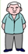

Other Allocation Types
Population
Sample
Notes:
In other allocation types, we get to decide for ourselves.
In this example, suppose we want a national estimate of disease prevalence, but really, we are most interested in an estimate of prevalence for stratum #2. What we could do is oversample from stratum #2 to ensure the precision of the stratum #2 estimate is high. Then we can also sample from the other stratums as well. So there are many possibilities for what you can do.

Slide 11
Cluster Sampling
Cluster sampling is the process of:
Dividing members of the population into non-overlapping and mutually exhaustive subgroups (clusters)
Selecting a sample of clusters
Sampling within each cluster

Slide 12
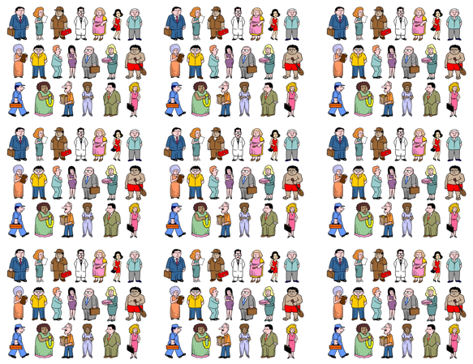
What is Cluster Sampling?
Population
1
2
3
4
5
6
7
8
9
10
11
12
13
14
15
16
17
18
19
20
21
22
23
24
26
27
28
29
30
25
31
32
33
34
35
36
Notes:
Ok so now moving on to cluster sampling. Here you can see that we have this big population of people. And if you look closely you can see that these squares form some natural divisions. So you can see that the population could be divided up into 36 clusters. So what we can do is sample a select subset of these clusters.
So we can chose these 6 clusters and then sample independently from each cluster

Slide 13
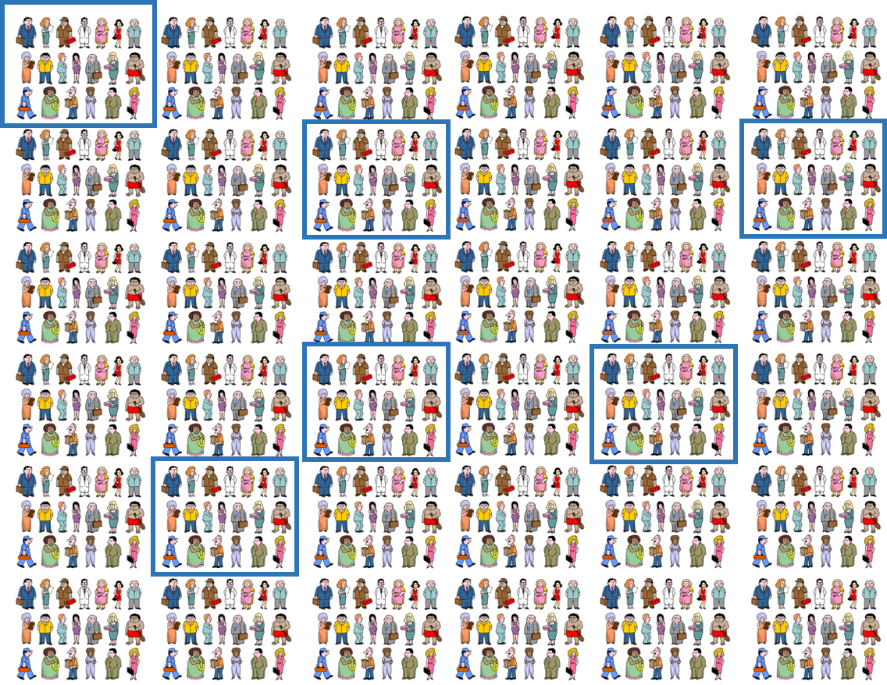
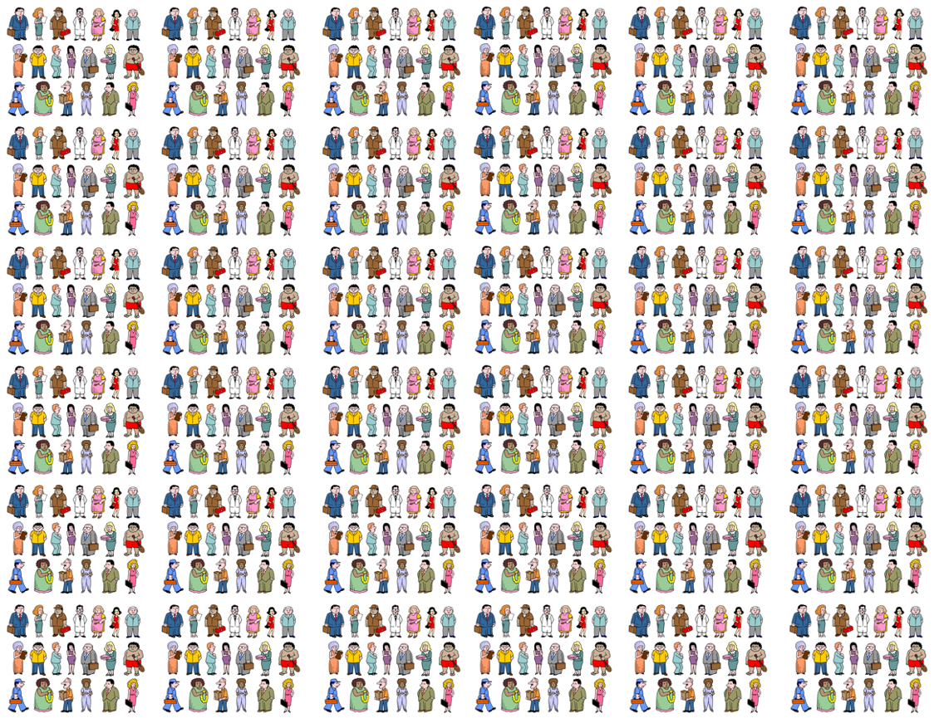

What is Cluster Sampling?
Population
Chosen Clusters
Sample
Notes:
So what you do is then select a sample of clusters from the population, and then within those clusters you sample again.
This is a two stage cluster design.

Slide 14
What is Cluster Sampling?
Population
Sample
Notes:
So what you do is then select a sample of clusters from the population, and then within those clusters you sample again.
This is a two stage cluster design.

Slide 15


What is Cluster Sampling?
Population
Chosen Clusters
Chosen Clusters within clusters
Sample
Notes:
So what you do is then select a sample of clusters from the population, and then within those clusters you sample again.
This is a two stage cluster design.

Slide 16
Cluster Sampling
Advantages
Can be much cheaper and convenient
Can sample more people
Disadvantages
Generally provides less precision than simple random sampling or stratified sampling
More complex to analyze the results (compared to simple random sampling)
Cluster sampling should be used when it is economically justified
When reduced costs can be used to overcome losses in precision
Notes:
You can sample more people because fro
from a practical standpoint you can focus more resources in a limited geographic area.
In practice we really use cluster sampling all the time. Because without clustering your survey teams would have to travel all over the country to do their sampling. So logistically cluster sampling makes way more sense. It is a little bit less precise, but you can also effectively sample way more people.

Slide 17
General thoughts on sampling design
Many possible ways to sample from a population
Ideal sampling design depends on the goals of the study
What estimates do you want?
National
Regional (city, county, governorate, town)
Subgroups (male/female, urban/rural)
What resources do you have?
Time
Money
Notes:
So these are the sort of things you should be considering in the design stage.
What are your time constraints? What is your budget?

Slide 18
Design Effect
The ratio of the variance of an estimator using the chosen sample design to that of the estimator under a simple random sampling design.
In a cluster sample DEFF will be >1
In a stratified sample DEFF will be <1
The main components of the design effect are the intraclass correlation, and the cluster sample sizes.
DEFF = 1 + d (n – 1)
d is the intraclass correlation (for the statistic in question)
n is the average size of the cluster
Intraclass correlation measures the similarity of a statistic within clusters
Notes:
In a cluster sample the DEFF will be greater than 1 because there is more variability in a cluster design than there is in a simple random sample design
In a stratified sample the DEFF will be less than 1 because there is less variability in a stratified design than there is in a simple random sample.
Another way to look at the design effect is to use the formula with intraclass correlation and cluster size.
So in general if the intraclass correlation is higher, the design effect is larger.
And if the cluster size is larger, the design effect is also larger

Slide 19
Case Study: Georgian Serosurvey

Slide 20
Georgian Serosurvey
A cross-sectional, nationally representative seroprevalence survey of individuals ≥18 years was conducted in Georgia from May-August 2015
Designed to provide nationals estimates of:
HCV infection
HBV infection
Selected non-communicable diseases.
HCV seroprevalence is the primary outcome of interest
Sample size calculations were based on the expected prevalence of anti-HCV antibody in the adult population
Epidemiologic data collected included:
Demographics
Medical history
Behavioral history
Knowledge of HCV transmission and prevention methods
HCV risk factors
Data were weighted based on probability of selection and calibrated using census data on sex, age, and geography
Notes:
Sample size was based on prevalence of Hep C

Slide 21
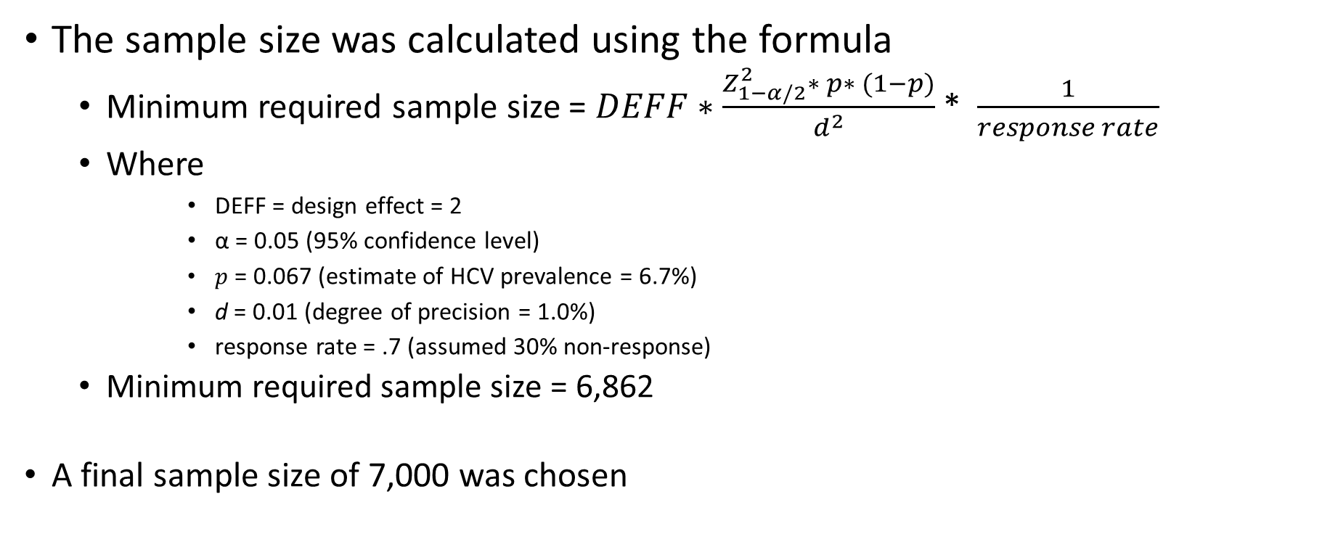
Sample Size and Power Calculations
The sample size was calculated using the formula
Minimum required sample size = $DEFF∗\frac{Z_{1−α/2}^{2}∗ p∗ (1−p)}{d^{2}}$ * $\frac{1}{response rate}$
Where
DEFF = design effect = 2
α = 0.05 (95% confidence level)
$p$ = 0.067 (estimate of HCV prevalence = 6.7%)
d = 0.01 (degree of precision = 1.0%)
response rate = .7 (assumed 30% non-response)
Minimum required sample size = 6,862
A final sample size of 7,000 was chosen
Notes:
Here is how we calculated the overall sample size for the national survey. We used the formula below which is a standard sample size formula.
DEFF is the design effect which we assumed was equal to 2. You usually base you assumption about the design effect on previous literature. There other studies using similar methodology that found design effects at the level, so that’s what we used for our assumption.
Alpha = .05 is the standard confidence level
P = .067 this is based on the estimated HCV prevalence in the country before the study
D = 0.01. This is the degree of precision. We wanted an estimate that would be with 1% of the true parameter.
Then response rate .7 so we factored in the possibility that there would be a decent amount of non-response.
So using those assumptions we then came up with a sample size of 6,862 which we then rounded up to 7,000 to be conservative

Slide 22
Study Design
To select the sample of 7,000 adults, we will use a stratified, multi-stage cluster design
Multi-stage design - there are 4 stages of sampling:
Strata
Clusters
Households
Participants
Notes:
There were 4 stages of sampling. First we chose strata, then clusters, then households, then individual participants

Slide 23
Stage 1: Stratification
The population was divided into 16 strata:
6 self-representing cities
Tbilisi, Kutaisi, Batumi, Zugdidi, Telavi, Rustavi
10 regional areas outside these cities.
Adjara, Guria, Imereti, Kakheti, Mtskheta-Mtianeti, Racha-Lechkhumi and Kvemo Svaneti, Samegrelo-Zemo Svaneti, Samtskhe-Javakheti, Kvemo Kartli, and Shida Kartli
These strata are:
Non-overlapping (each person is in only 1 stratum)
Collectively exhaustive (the strata include all members of the population)

Slide 24
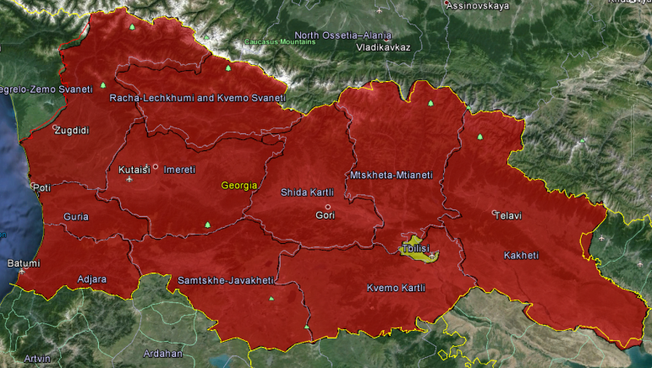
Stage 1: Stratification
Example of a stratum:
Tbilisi

Slide 25
Allocation of sample
Allocated a sample size of 1,000 persons (or 40 clusters x 25 persons per cluster) to Tbilisi
expected precision of ±2.7%
Allocated a sample size of 400 persons (or 16 clusters x 25 persons) to each of the other five large cities
expected precision of ±4.5%
This strategy left 4,000 people (or 160 clusters x 25 persons) to be allocated proportionally across the ten regional areas
expected range of precision from ±1.7% to ±2.9%
Note: Independent estimates for 4 regions will not be obtained due to the low number of clusters allocated to these regions during population proportional to size (PPS) sampling.
Notes:
Now, we had talked before about how whenever you are using stratification, you need to decide how you want to allocate your sample.
In this study, we decided to use a custom allocation scheme. Since first priority of the survey was to get a precise estimate of Hep C prevalence for the city of Tbilisi, we allocated a 1,000 people to be sampled from Tbilisi.
Our secondary priority was to get good estimates for the other 5 cities, so we did some sample sizes and decided to allocated 400 people to the other 5 cities.
Then, we proportionally allocated the remaining sample to the 10 regional areas.
The sample of 7,000 surveys will be allocated over these 16 strata in a way that allows independent city-level estimates for the major cities, as well as an overall nationwide estimate and separate urban and rural estimates.

Slide 26
Stratum
Stratum | City | Region | 2014 Civil Registry Population of City* | Cluster allocation
1 | Tbilisi | Tbilisi | 969,514 | 40
2 | Batumi | Adjara | 135,284 | 16
3 | Kutaisi | Imereti | 153,548 | 16
4 | Telavi | Kakheti | 19,663 | 16
5 | Rustavi | Kvemo Kartli | 109,566 | 16
6 | Zugdidi | Samegrelo-Zemo Svaneti | 35,420 | 16
 |  | Total | 1,422,995 | 120
Stratum | City | Region | 2014 Civil Registry Population (after capitol city removed) | Cluster allocation
7 | N/A | Adjara | 171,634 | 14
8 | N/A | Guria | 113,223 | 9
9 | N/A | Imereti | 392,028 | 31
10 | N/A | Kakheti | 295,004 | 23
11 | N/A | Mtskheta-Mtianeti | 88,828 | 7
12 | N/A | Racha-Lechkhumi and Kvemo Svaneti | 35,630 | 3
13 | N/A | Samegrelo-Zemo Svaneti | 257,288 | 20
14 | N/A | Samtskhe-Javakheti | 153,978 | 12
15 | N/A | Kvemo Kartli | 298,517 | 23
16 | N/A | Shida Kartli | 233,727 | 18
 |  | Total | 2,039,857 | 160
Notes:
Here is a table that shows the 16 strata and their respective populations. It also shows the number of clusters we planned to allocate to each strata.

Slide 27
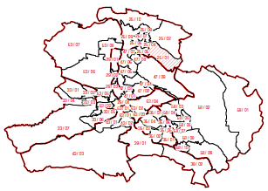

Stage 2: Clustering
Each stratum is divided into multiple clusters
Notes:
The next stage was clustering so within each of those 16 strata we divided the population into clusters. Then we chose a sample of clusters where we actually conducted the survey. In any of those clusters the next step was to choose a household

Slide 28
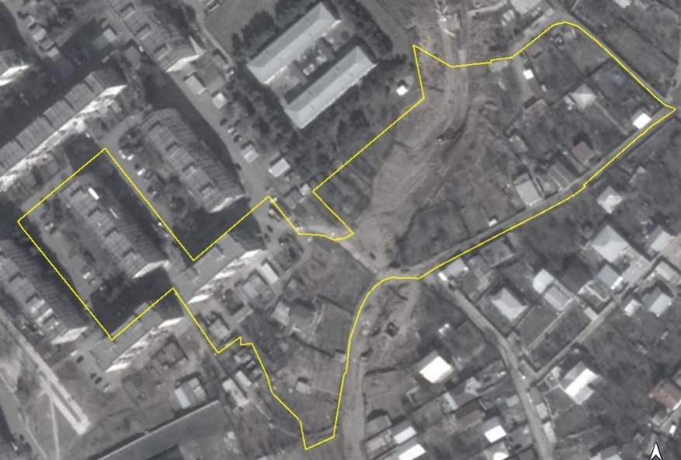
Stage 3: Selected Households
Team leads selected 25 households from each cluster to include in the sample using:
Population data
Printed maps
Skip pattern
Notes:
To do this, team leads used population data and printed maps and mapped out the households in each cluster to prepare a sampling frame. Then they could chose households based on the sampling interval.
**
Your team lead will provide a base map of each segment assigned to you. This will help you to recognize the precise boundaries of the segment. It is essential that you carefully study the base map as you prepare for fieldwork so that you are familiar with the area within the segment. In the field, you must be able to easily transfer your paper knowledge to the three-dimensional world in which you operate. The better prepared you are, the easier this transition will be, and the better the quality of the entire GATS.

Slide 29
Steps to select households
Began at a random starting point in the cluster
Chosen beforehand based on the cluster map
Used a skip pattern to select households (e.g., every 4th eligible household)
The skip pattern was based on the population of the cluster
For a larger population, the skip number will be larger
For a smaller population, the skip number will be smaller
Repeated until 25 households had been selected from the cluster
Notes:
Once the sampling frame was completed and survey teams were on the ground, there were 3 main steps taken to select households.
So for example if the skip interval was 4, they would chose every 4th household

Slide 30
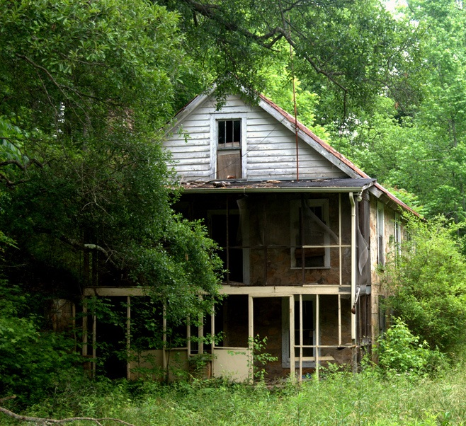
Verified the selected household meets the definition:
Households could be:
One person living alone
or
A group of people, who may or may not be related, living in the same place and preparing meals together
Households were not eligible if they were:
Abandoned
Summer home or vacation residence
not someone’s primary residence
Notes:
When you are going to these homes you need to make sure that they meet the definition for a household.
We also had some exclusion criteria

Slide 31
Household Selection Example
The sampling interval was calculated based on the estimated number of households in a cluster and the desired sample size
Cluster population = 100
Need to select 25 households from the cluster
Sampling interval = 100/25 = 4
2. Households were systematically sampled using the sampling interval
Team lead selects every 4th household to be interviewed
1
2
3
4
1
2
3
4
Abandoned
1
2
3
4
At home – select participant
At home – select participant
Not at home – leave contact information and revisit
Notes:
As an example, if the population of a cluster is 100 and we need to sample 25 households, then our sampling interval will be 4.
In other words, we will go through the cluster sampling every 4th household.
Keep in mind that if a house is abandoned or doesn’t fit the inclusion criteria it should be skipped.
If the residents aren’t home than you leave you contact information and come back later to revisit

Slide 32
Stage 4: Selected a participant
Explained the purpose of the survey to an adult in the household
Made a list of all eligible household members
Chose one person randomly based on a Kish Grid
If the selected person was not at home, we left contact information to schedule a re-visit
If selected person was at home, we began the interview
Notes:
In the 4th stage, after we selected a household, we had to choose a participant from that household. There are 5 steps for selecting a participant

Slide 33
Eligibility Criteria
Household members are eligible if:
Is an adult (≥18 years old)
Spent the last night in the household*
Gives informed consent
* Includes resident domestic employees
* Will discuss exceptions during interviewer module
Notes:
Keep in mind all the people who are listed need to be eligible.

Slide 34
Exclusion Criteria
Household members were excluded if they were:
Children or teenagers aged <18 years
Adults unable to give blood due to severe illness
Any participants refusing participation
Temporary household guests
Household members who live in another city or country
Notes:
We also have exclusion criteria for individual participants.
Household members were excluded if they were children or teenagers less than 18 years old.

Slide 35
Stage 4: Selected a Participant
Kish Grid:
The participant was chosen randomly based on the household number and the number of eligible adults in the house
Example:
10th household in the cluster
3 total eligible household members
Select household member #1
Eligible people | Age | Sex | Initials | Household Number
 |  |  |  | 1 | 2 | 3 | 4 | 5 | 6 | 7 | 8 | 9 | 10 | 11 | 12 | 13 | 14 | 15 | 16 | 17 | 18 | 19 | 20 | 21 | 22 | 23 | 24 | 25
1 | 34 | M | N.M. | 1 | 1 | 1 | 1 | 1 | 1 | 1 | 1 | 1 | 1 | 1 | 1 | 1 | 1 | 1 | 1 | 1 | 1 | 1 | 1 | 1 | 1 | 1 | 1 | 1
2 | 37 | F | S.S. | 1 | 2 | 1 | 2 | 1 | 2 | 1 | 2 | 1 | 2 | 1 | 2 | 1 | 2 | 1 | 2 | 1 | 2 | 1 | 2 | 1 | 2 | 1 | 2 | 1
3 | 85 | M | J.M. | 1 | 2 | 3 | 1 | 2 | 3 | 1 | 2 | 3 | 1 | 2 | 3 | 1 | 2 | 3 | 1 | 2 | 3 | 1 | 2 | 3 | 1 | 2 | 3 | 1
4 |  |  |  | 1 | 2 | 3 | 4 | 1 | 2 | 3 | 4 | 1 | 2 | 3 | 4 | 1 | 2 | 3 | 4 | 1 | 2 | 3 | 4 | 1 | 2 | 3 | 4 | 1
5 |  |  |  | 1 | 2 | 3 | 4 | 5 | 1 | 2 | 3 | 4 | 5 | 1 | 2 | 3 | 4 | 5 | 1 | 2 | 3 | 4 | 5 | 1 | 2 | 3 | 4 | 5
6 |  |  |  | 1 | 2 | 3 | 4 | 5 | 6 | 1 | 2 | 3 | 4 | 5 | 6 | 1 | 2 | 3 | 4 | 5 | 6 | 1 | 2 | 3 | 4 | 5 | 6 | 1
7 |  |  |  | 1 | 2 | 3 | 4 | 5 | 6 | 7 | 1 | 2 | 3 | 4 | 5 | 6 | 7 | 1 | 2 | 3 | 4 | 5 | 6 | 7 | 1 | 2 | 3 | 4
8 |  |  |  | 1 | 2 | 3 | 4 | 5 | 6 | 7 | 8 | 1 | 2 | 3 | 4 | 5 | 6 | 7 | 8 | 1 | 2 | 3 | 4 | 5 | 6 | 7 | 8 | 1
9 |  |  |  | 1 | 2 | 3 | 4 | 5 | 6 | 7 | 8 | 9 | 1 | 2 | 3 | 4 | 5 | 6 | 7 | 8 | 9 | 1 | 2 | 3 | 4 | 5 | 6 | 7
10 |  |  |  | 1 | 2 | 3 | 4 | 5 | 6 | 7 | 8 | 9 | 10 | 1 | 2 | 3 | 4 | 5 | 6 | 7 | 8 | 9 | 10 | 1 | 2 | 3 | 4 | 5
Notes:
So in this Kish grid we listed out all of the eligible adults residing in the household. Then, based on the household number the kish grid will give us a random number. And that number corresponds to the household member who we chose.

Slide 36

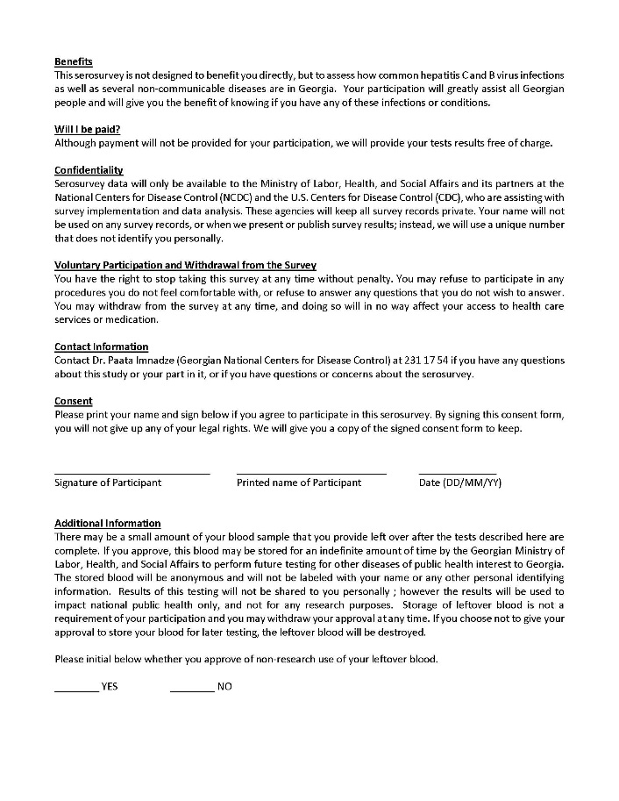
Obtain consent for interview

